Slide 1
Distributed Computing with Ray: Transforming Local Python Applications into Scalable Systems
Bhagirathi Hegde
Sarath Srinivas

Slide 2
Agenda
The problem of scaling python programs
Ray core concepts
How to start a ray cluster
Benefits of Ray over other distributed computing options
Ray libraries - What are Ray Data, Train, Tune and Serve
Ray Serve hands-on

Slide 3
Github repo
https://github.com/bhagirathi-hegde/ray-talk

Slide 4
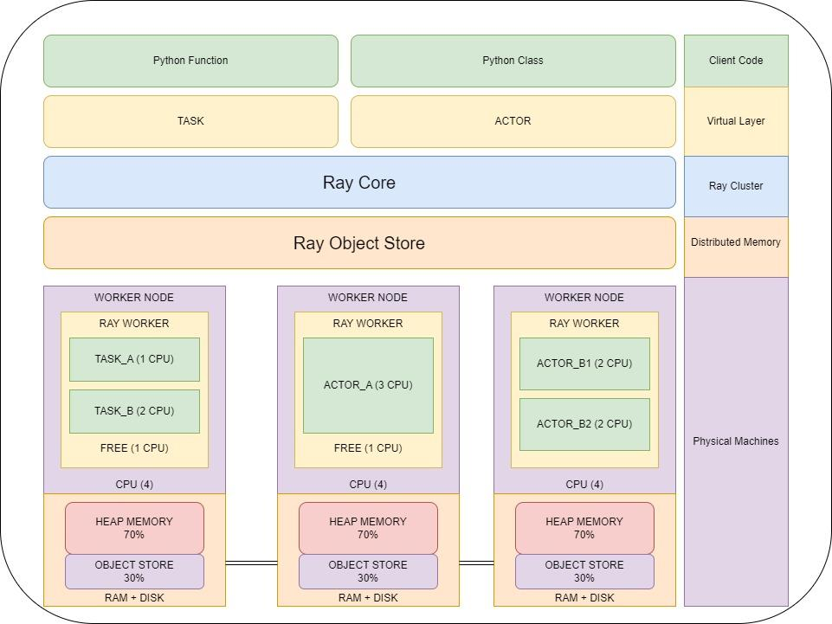

Slide 5
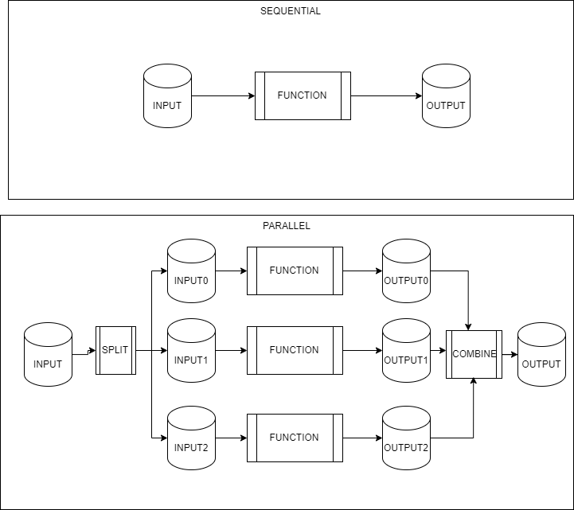

Slide 6


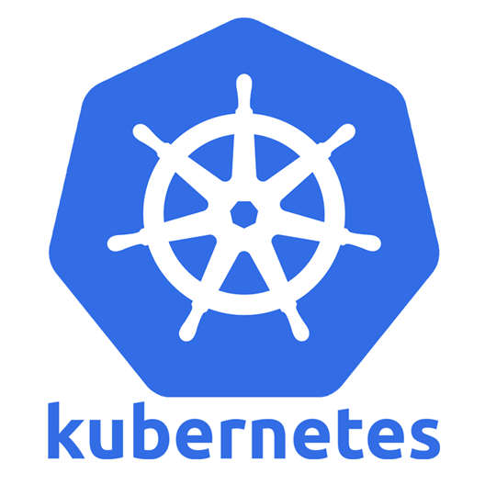

Benefits of Ray over other distributed computing options
Python-centric
Flexible and general-purpose
Scales efficiently
Optimized for real-time and low-latency applications
vs
MapReduce centric, dataflow-based – limited task flexibility
Natively scala
Complex, Limited task management
Mostly Data Parallel/ Mapreduce oriented
Notes:
Spark - support for Python is somewhat secondary and may come with performance trade-offs

Slide 7
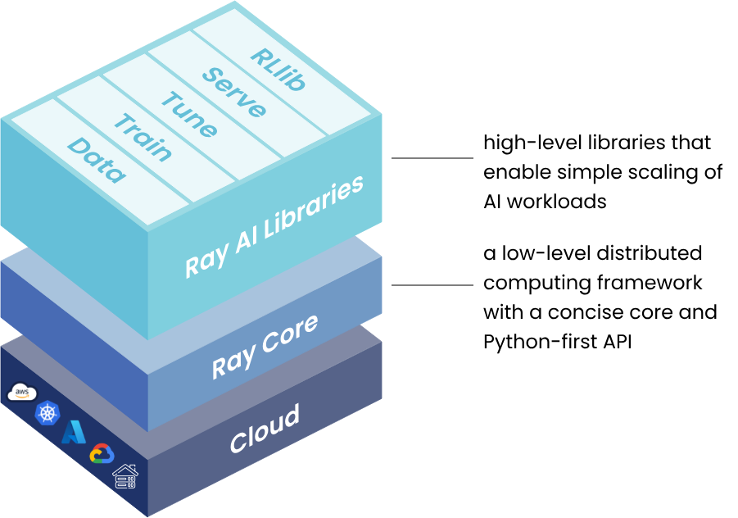
Ray Frameworks
Source: https://docs.ray.io/en/latest/ray-overview/index.html#ray-framework
Notes:
Ray Train abstracts away the complexity of setting up a distributed training system.
Ray Serve: A production-ready model serving library built on Ray for deploying machine learning models as web services.

Slide 8
Summary
Local ray cluster
Converted single processor python code to multi-core on local ray cluster
Connected to remote ray cluster
Distributed computing on remote ray cluster
From program on laptop to a high-performance distributed application with few additional lines of python code

Slide 9
Resources
Ray documentation
https://github.com/bhagirathi-hegde/ray-talk

Slide 10
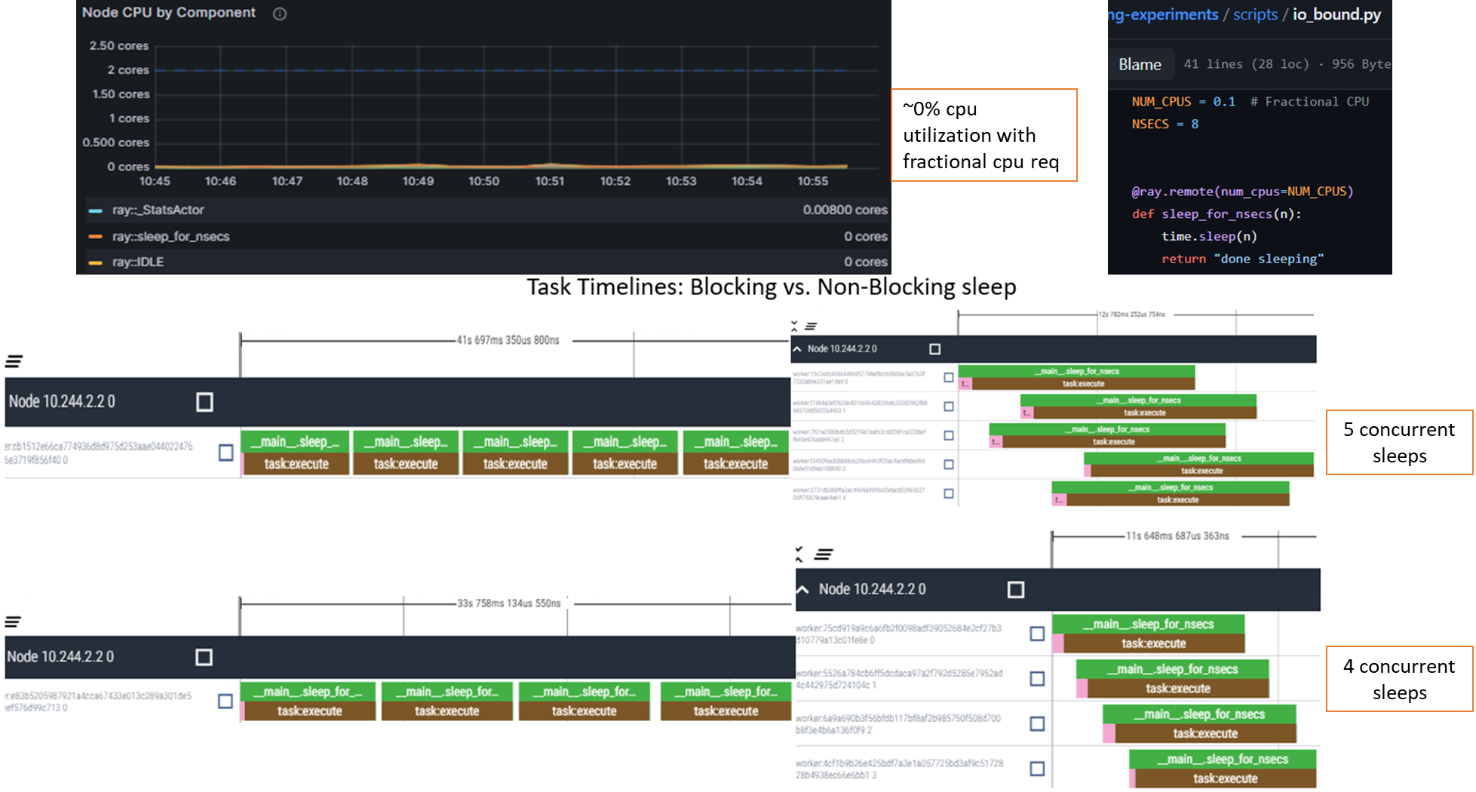
Run Hybrid Workloads
By using fractional CPU for I/O Bound tasks

Slide 11
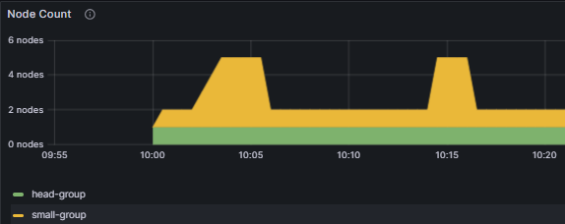
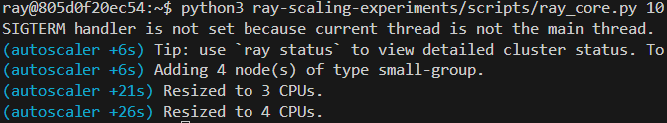
Autoscaler with kuberay
Ray scales up and down resources dynamically based on requirements/requests

Slide 12
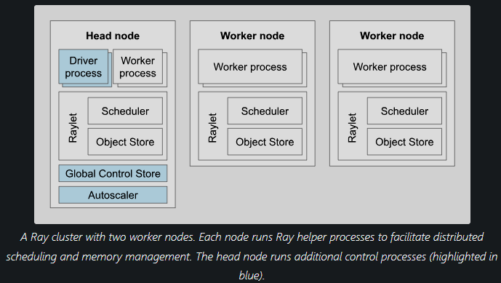
Ray cluster
S
Source: https://docs.ray.io/en/latest/cluster/key-concepts.html#ray-cluster
Notes:
A Ray cluster consists of a single head node and any number of connected worker nodes

